Slide 1
Who’s the Happiest?
Are younger, white males the happiest?
Ryan D’souza

Slide 2
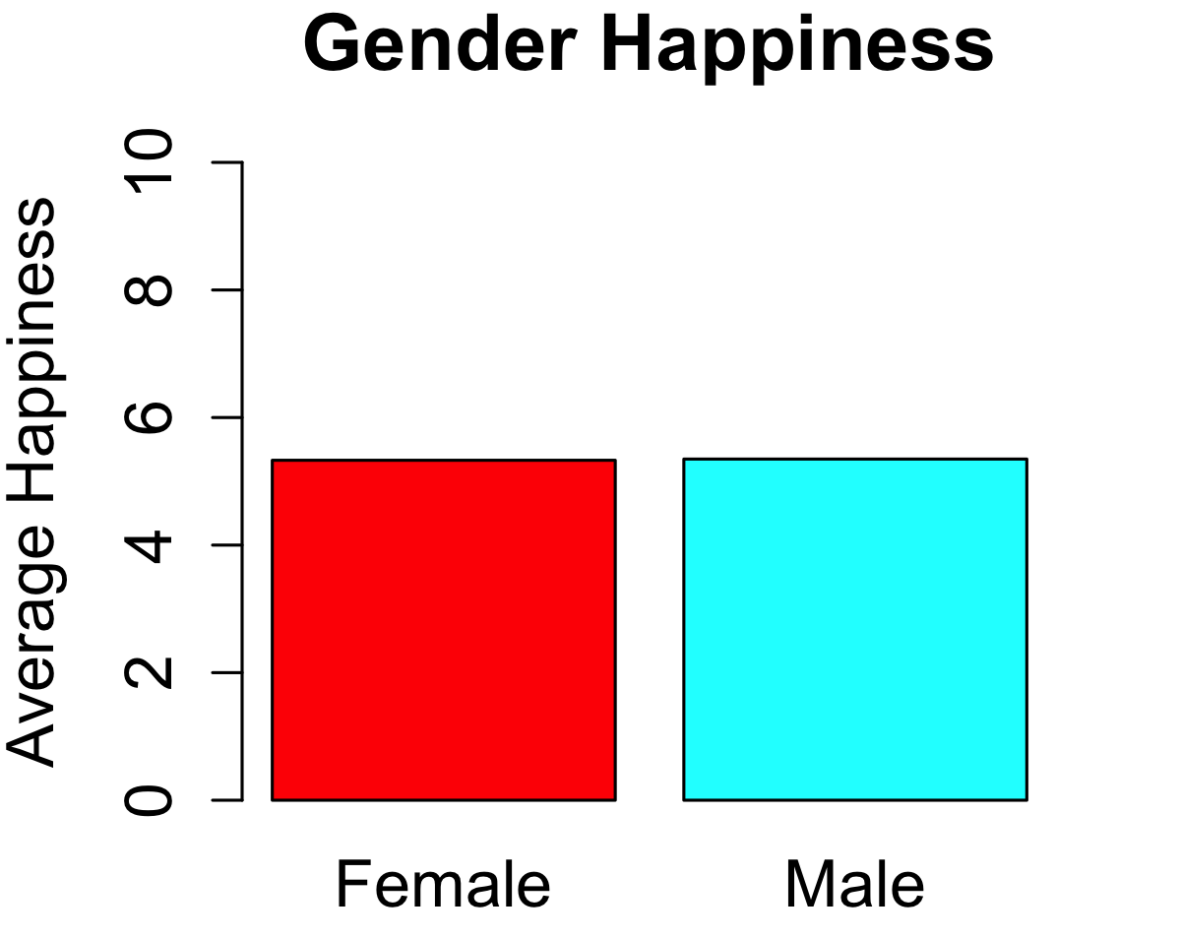
Which gender is happier?
How many males or females?
What about outliers?

Slide 3
Is it a tie? Nope
Males are slightly happier
The average male rates themselves at 5.349
The average female rates themselves at 5.330
Male extremes are also happier
Lowest Male Score: 2.660
Lowest female score: 2.640
Highest Male Score: 8.380
Highest female score: 8.370
3rd Quartile Male Score: 6.240
3rd Quartile female score: 6.223
How was this data collected?
Phone surveys? Random approach?

Slide 4
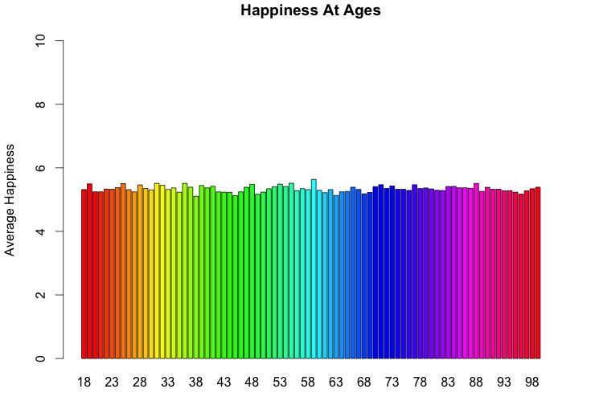
What age is happiest?
What about outliers?
What time of day was this data selected?

Slide 5
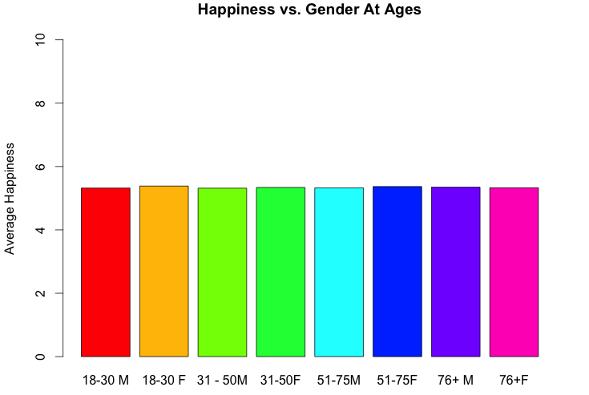
A Clearer View
How is income level reflected? Were the samples from all income levels?

Slide 6
Darn
Would having children have an effect on happiness?
Were an equal number of adults with and without children surveyed?
No specific age is happiest
I always thought the elderly would have been the happiest
The means were:
Young Adults (18-30): 5.3515
Middle-aged Adults (31-50): 5.3286
Elderly (51-75): 5.348
Really Elderly (76+): 5.3398
It seems like we start off happy, become sad (because of children?), become happy again (children left the house?), before recessing slightly

Slide 7
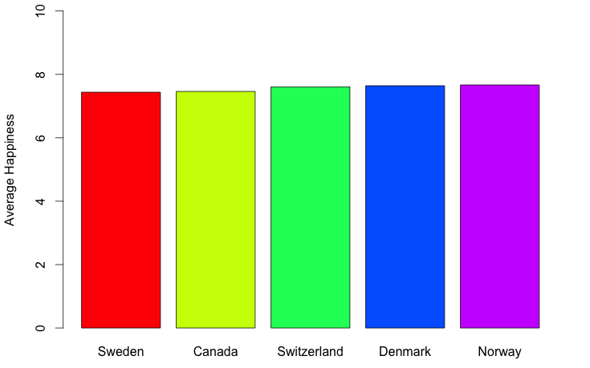
Which countries are the happiest?
These regions have awful (and long) winters. What season(s) was this data collected from?

Slide 8
Europe
Norway, Denmark, and Switzerland are the happiest countries:
Norway: 7.6668
Denmark: 7.6421
Switzerland: 7.6062
Average happiness: 5.3274
Norwegians are 43.91% happier than the rest of the world
Once again, what about outliers? What’s the sample size for this?

Slide 9
Let’s go deeper
What if we combine age and gender to analyze happiness?

Slide 10
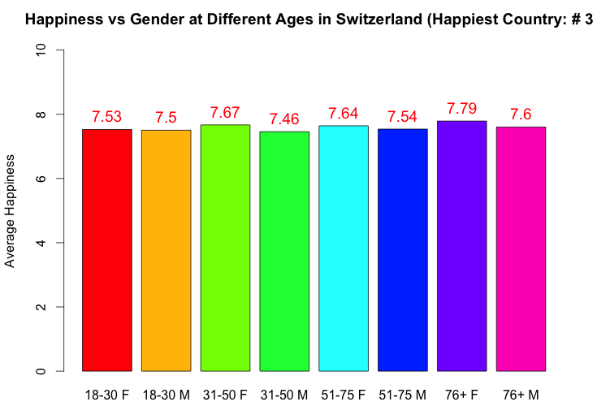
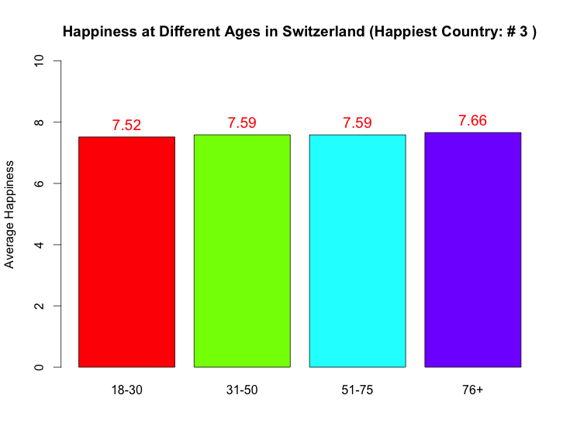
Age and Gender
It seems like elderly Swiss females are happiest, and young-adults are the saddest

Slide 11
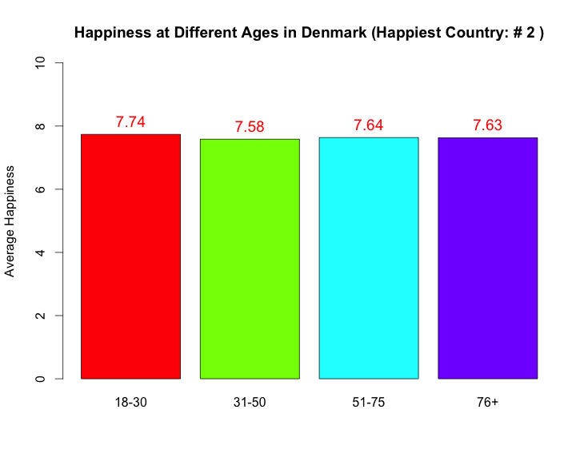
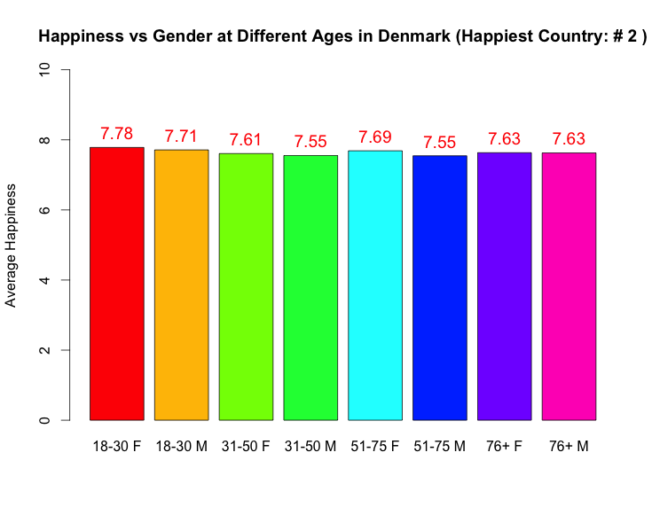
Continuing with Denmark
Young Danes are the happiest, followed by elderly, middle-aged, and really elderly

Slide 12
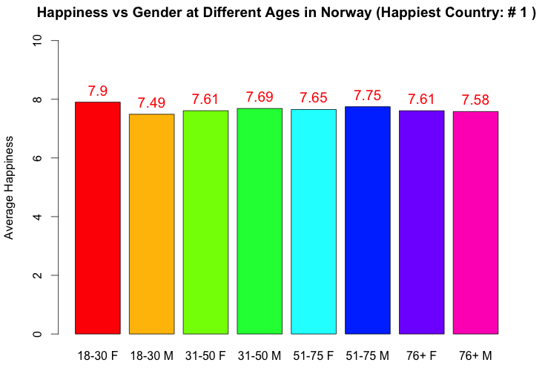
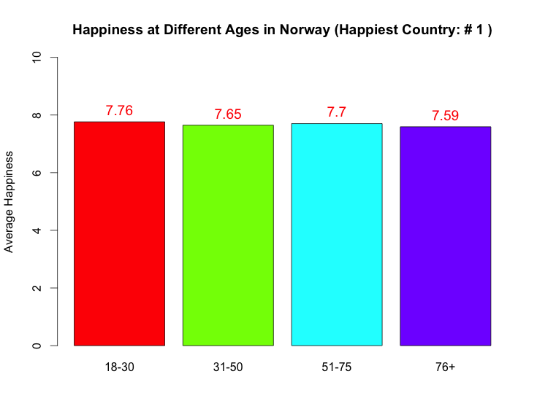
Ending with Norway
Similar to the Danish, young Norwegians are happiest

Slide 13
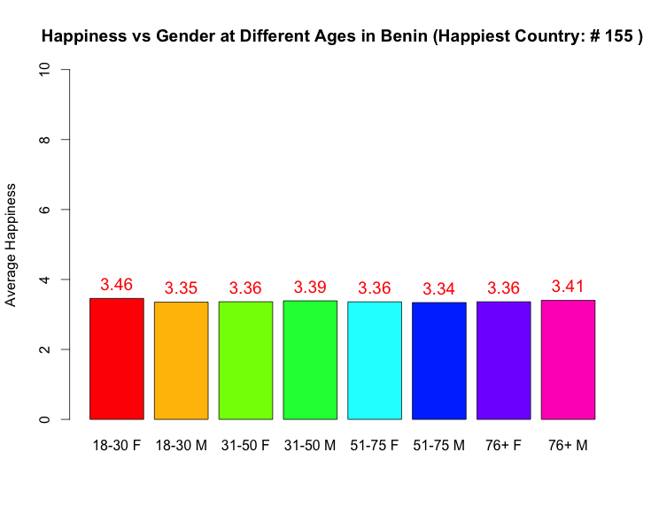
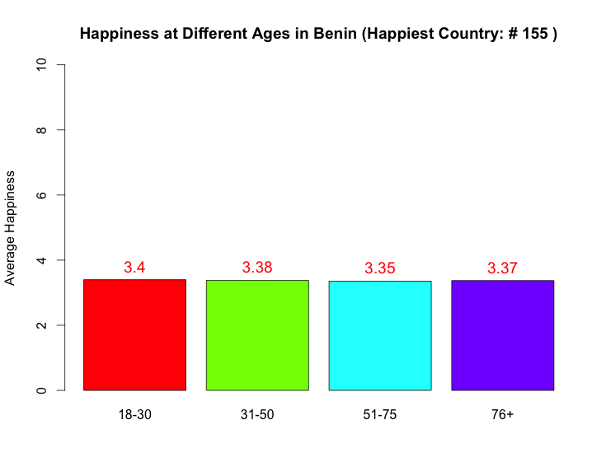
An unhappy country
Even in Benin, one of the unhappiest countries, the youth are the happiest

Slide 14
Drawing Conclusions
Happiest race/region:
Europeans
Happiest age groups
18-30 51-75 76+ 31-50
Happiest gender:
Males
Conclusion: Youths everywhere are happy, but young white males are more likely to be the happiest

Slide 15
P-Value Calculation
Hypothesis: Young adults (18-30) are happier than the rest of the population (30+)
Null Hypothesis: Young adults are not happier than the rest of the population

Slide 16
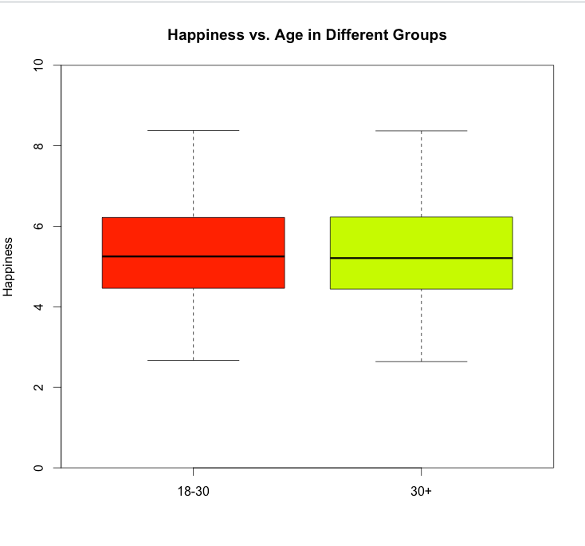
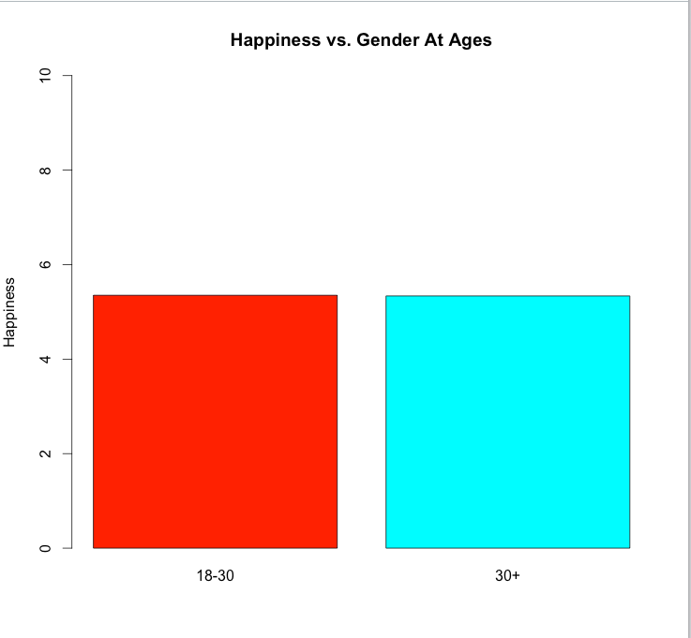
Happiness Distribution
Both groups look equally happy and have approximately the same distribution

Slide 17
Further Steps
Run some simulations
Number of simulations: 1,000
Use R’s “sample()” method
Calculate the average happiness for both groups in each of those 1,000 simulations, and store that average in the group’s respective array
Perform a T-Test on both arrays to calculate the P-value

Slide 18
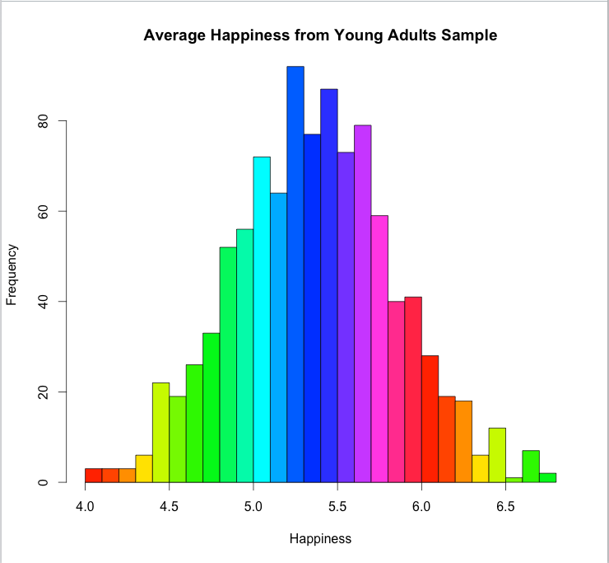
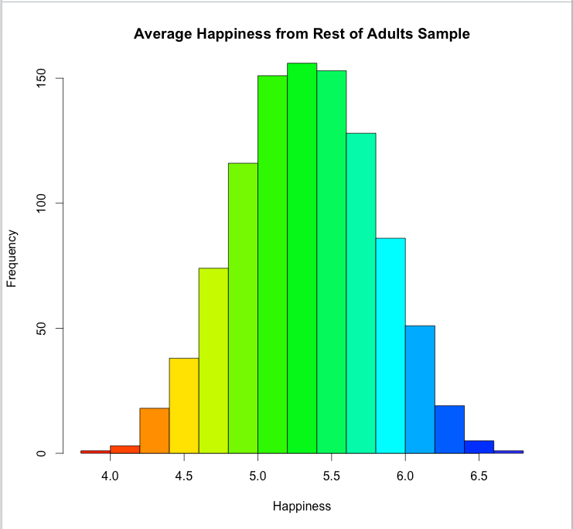
Simulation Results

Slide 19
Simulation Statistics
Results from using R’s “t.test(youngAdultSampleAverages, restOfAdultsSampleSaves)” (Welch Two Sample t-test)
T-value: 1.8571
Degrees of Freedom: 1995.1
Mean of young adults: 5.3678
Mean of rest of adults: 5.3287

Slide 20
Conclusions
P-Value: 0.06344
Because the P-value is greater than 0.05, we reject the null hypothesis and declare that young adults are happier than the rest of the population

